Slide 1
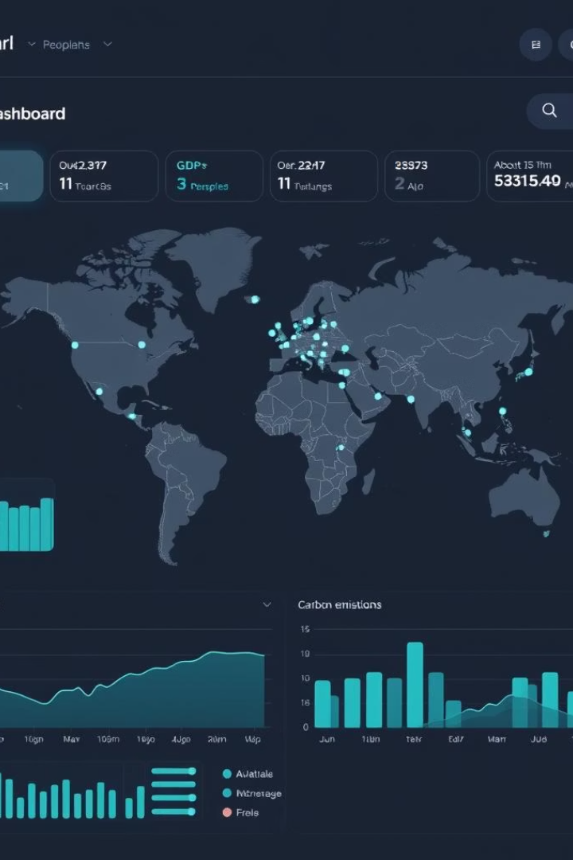
Financial Analysis Dashboard – 2015 Sales Insights
This presentation provides a visual representation of 2015 financial performance. It offers data-driven insights for strategic decisions, using data from the 'Financial Sample.xls' Excel file.

Slide 2

Project Overview
1
Objective
2
Scope
3
Deliverable
Analyze 2015 sales data for key trends.
Quarterly sales, product performance, customer segments.
Interactive dashboard with actionable insights.

Slide 3




Tools Used
Microsoft Excel
Initial data cleaning and manipulation.
Power BI
Dashboard creation and visualization.
Data Connectors
Excel workbook connection in Power BI.

Slide 4





Methodology
Data Extraction
Imported 'Financial Sample.xls' into Excel.
Data Cleaning
Removed duplicates and handled missing values.
Data Transformation
Created calculated fields, e.g., YoY growth.
Visualization
Designed charts and graphs in Power BI.

Slide 5
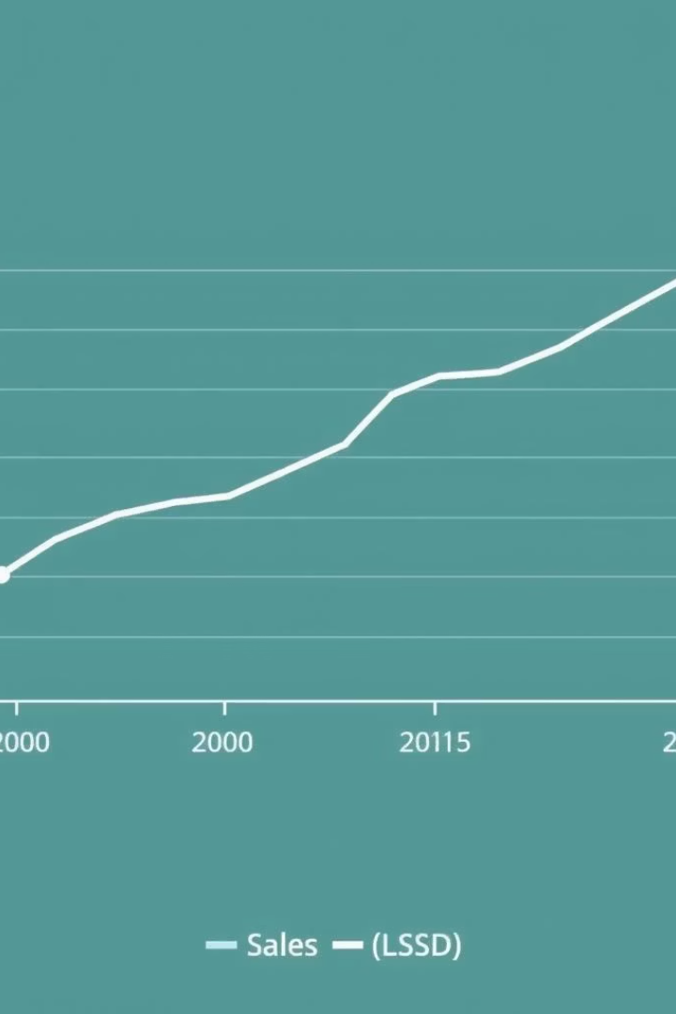
Quarterly Sales Growth
Q1
+25%
Q2
+10%
Q3
-5%
Q4
+15%
Notable sales spike in January 2015 (+25% vs. Q4 2014).

Slide 6
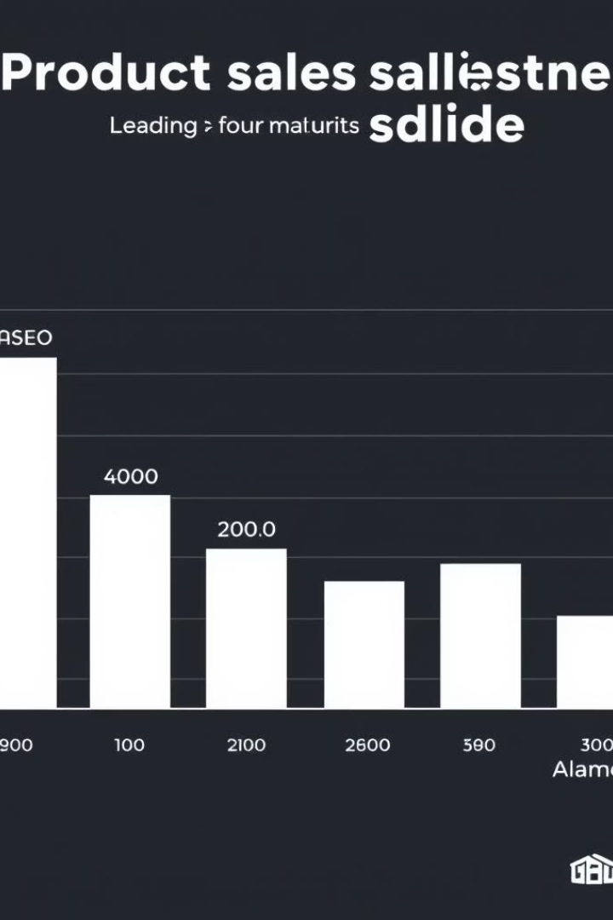
Product Performance
"Paseo"
"Montana"
Top-selling product (35% of total sales).
Strong, consistent performance.
"Carretera"
Lowest sales, requires strategic review.

Slide 7



Regional Sales Analysis
1
United States
2
Canada
3
France
United States has the highest sales volume (40% of total).

Slide 8
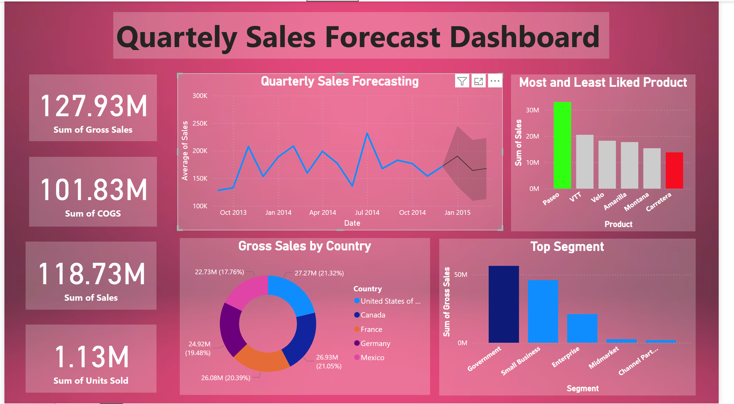

Slide 9






Customer Segmentation
Small Business
Significant, potential for growth.
Government
Top-performing segment (30% of sales).
Enterprise
Moderate sales, focus on account management.

Slide 10
Strategic Recommendations
Marketing
Product
Sales
Customer
Increase investment in Germany by 20%.
Relaunch "Carretera" with updated features.
Target Small Businesses with product bundles.
Focus on retention programs.

Slide 11

Conclusion
Insights
Strategies
Actionable insights derived from 2015 sales data.
Data-driven strategies for maximizing revenue.
Monitoring
Continuous monitoring for sustained growth.

